Slide 1


S.P.APPARELS LIMITED
FY 2021 - 2022
AGM PRESENTATION
September 2022

Slide 2
FY22 RESULT – KEY HIGHLIGHTS
FY22 YoY ANALYSIS
In Rs Mn
REVENUES ¹
Adj. EBITDA & EBITDA MARGIN ²
PBT* & PBT MARGIN ³
PAT & PAT MARGIN ³
33%
43%
94%
96%
Total revenues include realised gain on account of foreign exchange fluctuations (accounted in other income)
In addition to (1), EBITDA calculation excludes unrealised MTM gain / loss on account of foreign exchange fluctuations (accounted in other expenses) and prior to the exceptional item
PBT Margin = Reported PBT / Total Revenues ¹ , PAT Margin = Reported PAT / Total Revenues ¹

Slide 3
FY22 RESULT – DIVISION WISE ANALYSIS
In Rs Mn
DIVISION REVENUES SHARE | FY21 | FY22
Garment Exports | 82.2% | 85.7%
SPUK | 11.8% | 8.8%
Retail | 6.0% | 5.5%
FY22 YoY ANALYSIS – TOTAL REVENUE BREAKUP ¹
8,671.9
6,531.9
GROSS MARGIN % ² | FY21 | FY22
Garment Exports | 68.6% | 57.2%
SPUK | 8.8% | 9.0%
Retail | 21.6% | 23.1%
22%
-1%
38%
Adj. EBITDA MARGIN % ³ | FY21 | FY22
Garment Exports | 20.2% | 20.9%
SPUK | 5.3% | 3.5%
Retail | -13.1% | -10.7%
Total revenues include realised gain on account of foreign exchange fluctuations (accounted in other income)
Gross Margin (1) minus COGS
In addition to (1), EBITDA calculation excludes unrealised MTM gain / loss on account of foreign exchange fluctuations (accounted in other expenses)

Slide 4
FY22 RESULT – CONSOLIDATED PROFIT & LOSS STATEMENT
Particulars (In Rs Mn) | FY22 | FY21 | YoY%
Revenue from Operations | 8,594.3 | 6,523.1 | 31.8%
Gain on account of Foreign Currency Fluctuations | 77.6 | 8.8 | 784.9%
Total Revenues | 8,671.9 | 6,531.9 | 32.8%
COGS | 3,541.3 | 2697.73 | 31.3%
Gross Profit | 5,130.5 | 3,834.2 | 33.8%
Gross Margin | 59.2% | 58.7% | 46bps
Employee Expenses | 1,903.0 | 1,491.7 | 27.6%
Other Expenses excl. MTM gain / loss on account of Foreign Currency Fluctuations | 1,699.3 | 1,270.5 | 33.8%
Adj. EBITDA | 1,528.2 | 1,072.0 | 42.6%
Adj. EBITDA Margin % | 17.6% | 16.4% | 121bps
MTM (Gain) / Loss on account of Foreign Currency Fluctuations | -67.2 | 19.8 | -
Depreciation | 346.3 | 323.1 | 7.2%
Finance Cost | 118.5 | 142.8 | -17.0%
Other Income excl. Gain on account of Forex Fluctuations | 17.3 | 5.0 | 247.5%
PBT | 1,147.9 | 591.4 | 94.1%
Tax Expense | 301.0 | 159.7 | 88.5%
PAT | 846.9 | 431.7 | 96.2%
PAT Margin % | 9.8% | 6.6% | 316bps
Earnings Per Share (EPS) In Rs. | 32.96 | 16.80 | 96.2%
Total revenues include realised gain on account of foreign exchange fluctuations (accounted in other income)
In addition to (1), EBITDA calculation excludes unrealised MTM gain / loss on account of foreign exchange fluctuations (accounted in other expenses)
PAT Margin = Reported PAT / Total Revenues ¹

Slide 5
FY22 – CONSOLIDATED BALANCE SHEET
Particulars (Rs Million) | Mar-21 | Mar-22
Equities & Liabilities
Shareholder's Funds
Share Capital | 256.9 | 256.9
Other Equity | 5,326.9 | 6,120.8
Total Shareholder's Funds | 5,583.9 | 6,377.7
Minority Interest | -64.5 | -65.3
Non-Current Liabilities
a. Financial Liabilities
Borrowings (please refer note below) | 547.1 | 673.9
Other Financial Liabilities | 135.8 | 134.8
b. Deffered Tax Liabilities | 301.8 | 330.8
c. Other Non-Current Liabilities | 0.0 | 0.2
Total of Non-current liabilities | 984.7 | 1,139.7
Current Liabilities
a. Financial Liabilities
Borrowings | 1,282.1 | 1,461.5
Trade Payables | 911.4 | 1,189.5
Other Financial Liabilities | 276.0 | 374.6
b. Other Current Liabilities | 60.0 | 72.5
c. Provisions | 88.1 | 66.1
Total of Current liabilities | 2,617.5 | 3,164.1
Total Liabilities | 9,121.6 | 10,616.2
Particulars (Rs Million) | Mar-21 | Mar-22
Assets
Non-Current Assets
a. Property, Plant and Equipment | 4,007.6 | 4,105.1
b. Capital work in progress | 102.4 | 77.5
c. Intangible assets | 59.7 | 58.9
d. Financial Assets
Investments | 1.9 | 1.8
Loans & Advances | 0.0 | 0.0
Others | 209.8 | 399.2
e. Other non-current assets | 10.4 | 42.0
f. Right of use assets | 372.6 | 331.9
Total non-current assets | 4,764.4 | 5,016.3
Current Assets
a. Inventories | 2,413.5 | 3,320.3
b. Financial Assets
Trade Receivables | 1,166.8 | 1,086.1
Cash & Cash equivalents | 411.8 | 595.0
Others | 19.2 | 97.9
c. Other Current Assets | 346.0 | 500.7
Total current assets | 4,357.2 | 5,599.9
Total Assets | 9,121.6 | 10,616.2
Note : Long term debt includes right to use property obligation close to Rs. 332 Mn

Slide 6

^{COMPANY OVERVIEW}
Financial Overview & Shareholding Structure

Slide 7
BRIEF PROFILE
BUSINESS OVERVIEW
SPAL is one of the leading manufacturers and exporters of knitted garments for infants and children in India.
Provides end-to-end garment manufacturing from greige fabric to finished products including body suits, sleep suits, tops and bottoms.
Strong promoter pedigree with more than two decades of experience in textile and apparels industry.
KEY STRENGTHS
SPAL is a specialized player in the highly challenging infant & children wear knitted garment industry.
Preferred vendor through long standing relationships with reputed international brands etc.
Stringent quality compliance, superior in-house product development and certified testing laboratories.
Demonstrated ability to setup integrated facilities to scale-up operations. Currently operating 26 facilities having close proximity to key raw materials & skilled labour.
Advanced manufacturing machineries with latest technology and automation.
FINANCIAL OVERVIEW *
Reported Consolidated Revenues, EBITDA and PAT were Rs 8,672 mn, Rs 1,528 mn and Rs 847 mn in FY22.
Strong balance sheet with Net Debt to Equity ratio of 0.22x as on Mar-22.
Improving profitability & return ratios over FY15 to FY22-
  Reported PAT Margin: 1.7% to 9.8%
  Cash Adjusted ROCE: 13.4% to 17.2%
  ROE: 9.6% to 20.2%
ROE = PAT before MI / Avg. Equity (Excl. preference shares) + MI
Cash Adj. ROCE = EBIT / Avg. Capital Employed (excl. cash & current investments),

Slide 8
OUR EVOLUTION
2007-08
Amalgamation with Sri Balaji Bakkiam Spinning Mills
2003
Set-up first in-house embroidery facility at Thekkalur
2016
Listed on BSE / NSE
Repayment of Loans to reduce leverage
2008-13
Streamlining of operations to integrate the factories, increase efficiencies and increase backward integration
1989
Started export operations as a partnership firm
2004
Set-up of flagship factory
at Avinashi
1989-2003
Bootstrap Phase
2004-2008
Expansion Phase
2008-2015
Consolidation Phase
2016-22
Growth Phase
2005
Commissioned dyeing plant
at Perundurai
2014
Incorporation of SP Apparels UK to cater to increasing integration, get a closer-to-client presence, and develop new relationships
1998
Set-up manufacturing facility at Neelambur
2006
Investment by NYLIM in the Company
Investment in Joint Venture Company for manufacturing and marketing of “Crocodile” Brand
2017-22
Integration / expansion of manufacturing facilities to increase operational efficiency
Expansion of Crocodile brand in unexplored states and cities

Slide 9
LEADING EXPORTER OF INFANT & CHILDREN WEAR IN INDIA
SPAL IS A SPECIALIZED PLAYER IN THE HIGHLY CHALLENGING INFANT & CHILDREN WEAR KNITTED GARMENT INDUSTRY
INDUSTRY’S UNIQUE CHALLENGES
SPAL’S CORE COMPETENCIES
1
Demonstrated manufacturing excellence for over two decades
Labour intensive operations.
Employee training & skill development.
Employee occupational health & welfare.
SPAL is strongly placed to capitalize
on future growth opportunities
Clear understanding of buyer preferences and specifications of knitted garments and embellished garments in infants and children category
2
Demands large variety and small batch size orders.
Highly complex manufacturing.
Ability to consistently deliver high quality products on timely basis
3
Stringent safety and quality requirements in developed markets.
Severe restrictions on the use of chemicals, dyes, accessories and other additives to prevent any side-effects on infants and children.
Meeting stringent compliance requirements of international customers
Long standing relationships with reputed global brands
Note: Lower volumes in FY21 on account of Covid-19 related disruptions

Slide 10
PREFERRED VENDOR TO REPUTED INTERNATIONAL BRANDS
SPAL IS THE PREFERRED VENDOR
FOR KNITTED GARMENTS FOR INFANTS AND CHILDREN
TO REPUTED INTERNATIONAL BRANDS AND RETAILERS
WHY SPAL?
Expertise to concurrently manage multiple large orders with a diversified product range including body suits, sleep suits, tops and bottoms.
Ethically, Environmentally and Socially compliant organization.
No bulk returns from customers since inception.
Ability to offer end-to-end garments manufacturing services from the design to the manufacture of the garments.

Slide 11
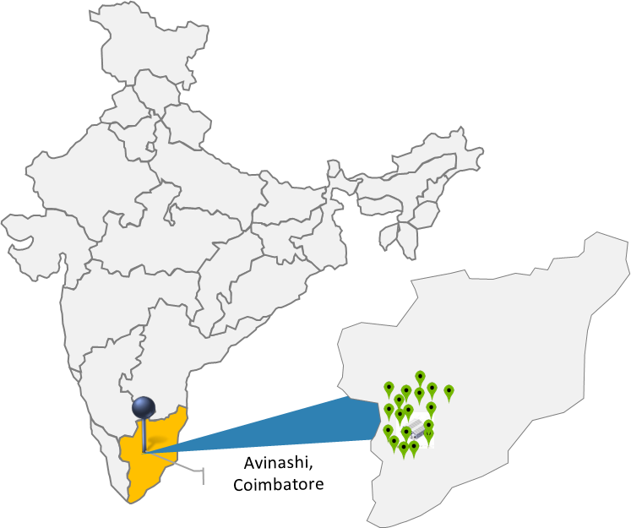
STRATEGICALLY LOCATED & INTEGRATED MANUFACTURING FACILITIES
INTEGRATED BUSINESS MODEL
LOCATION ADVANTAGE:
  All 18 manufacturing facilities are located within a radius of ~125 km of our Registered Office near Tirupur (leading hub in India for knitted garments for children and exports) leading to significant economies of scale.
  Convenient access to skilled labour and raw materials and also to machinery supplies and replacement parts.
  Significant savings in production, labour and transportation costs.
  Close proximity to international port.
Product Development
Order
Spinning
Knitting
Dyeing
TECHNOLOGY & AUTOMATION:
Eton conveyor production system (automated sewing assembly line and workflow control).
ASRS* for efficient warehouse / inventory management.
Orgatex software system for automation of dyeing related processes.
Garmenting
Export
* ASRS: Advanced semi-automated storage and retrieval system
In-house

Slide 12
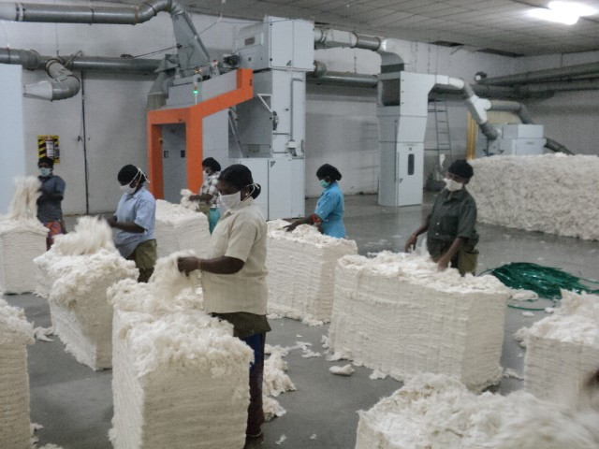
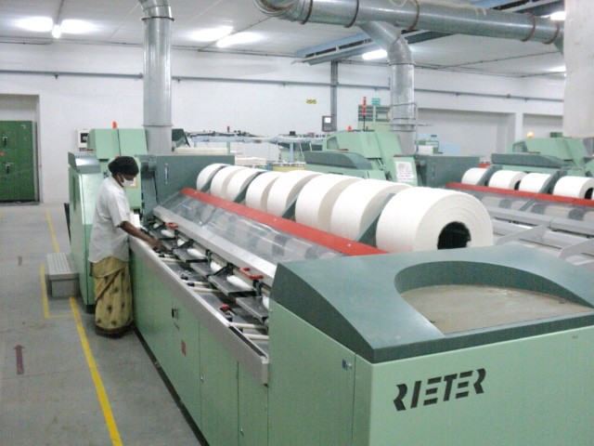
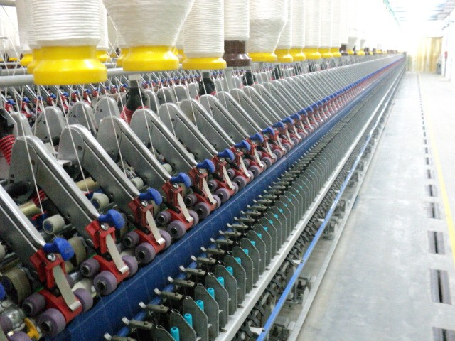
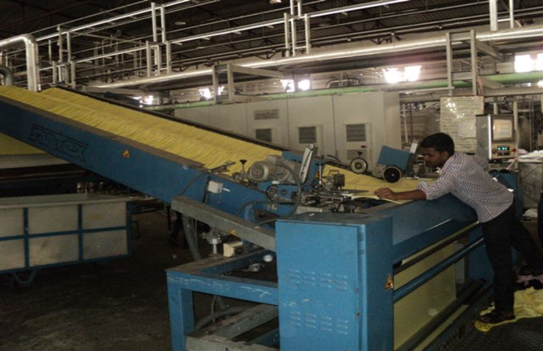
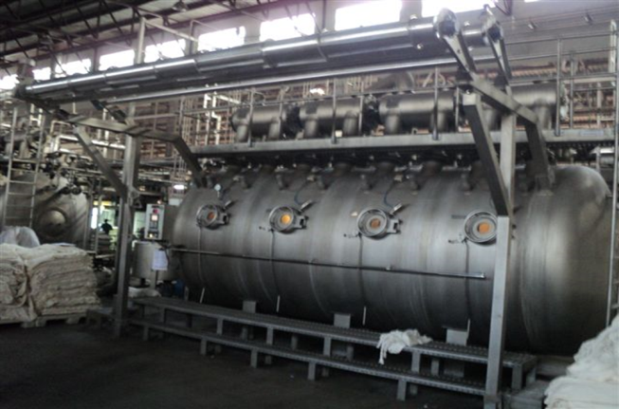
STRATEGICALLY LOCATED & INTEGRATED MANUFACTURING FACILITIES
Spinning
Dyeing

Slide 13
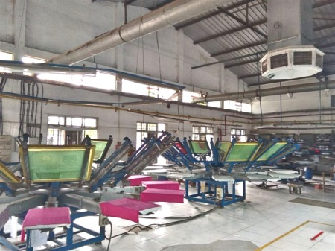
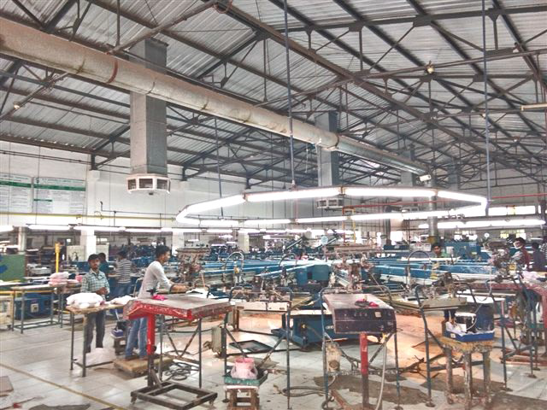
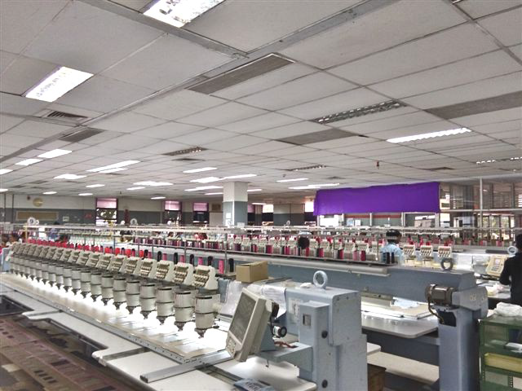
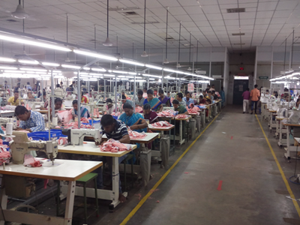
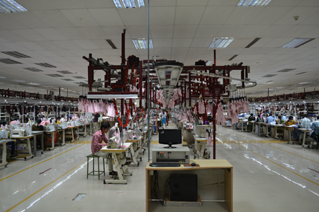
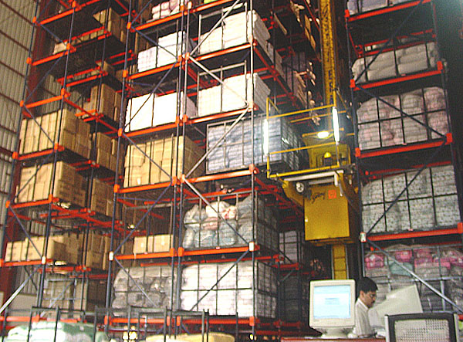
STRATEGICALLY LOCATED & INTEGRATED MANUFACTURING FACILITIES
Printing
Automated Embroidery
Sewing
Automated Sewing Assembly Line
Semi-Automated Inventory Management

Slide 14
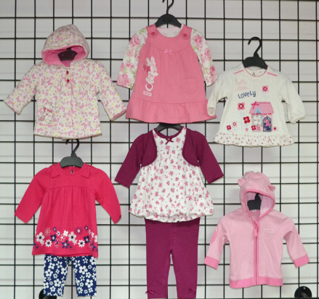
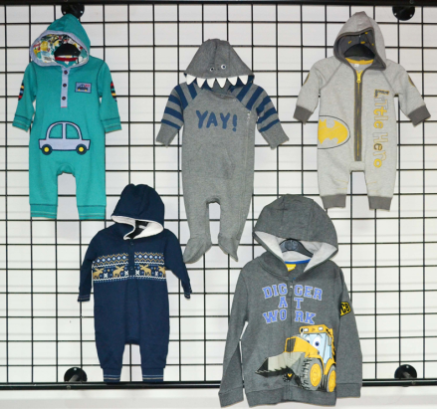
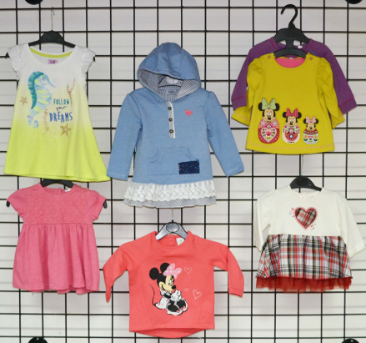
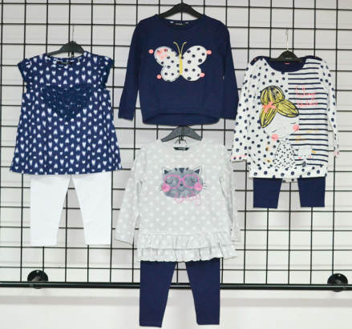
STRONG IN-HOUSE DESIGN EXPERTISE
STRONG DESIGN IS SPAL’S CORE COMPETENCY
SPAL’s core competency lies in understanding latest fashion and trends to suit the customers buying preferences.
Dedicated in-house design and merchandising team of designers located at our Corporate Office in India and design consultants hired by our Subsidiary, SPUK.
Use of latest technology for developing products and styles which are based on prevalent fashion trends.
Design development, sampling and fitment form an integral part of our operations and are considered as an effective tool for converting customer’s need into a finished product.

Slide 15



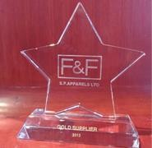

STRINGENT QUALITY CONTROLS & COMPLIANCE
Strong adherence to the highest standards of quality, assurance and compliance.
Stringent quality control checks consisting of inspection and testing of fabric, greige and processed yarn, trims, accessories, packing materials and of each piece of garment for metal bits/needle tips/sharp edges prior to packing.
Exercise stringent Quality check at every stage of manufacturing.
All individual pieces of garments are also physically inspected to ensure that no defective/damaged pieces are delivered to our customers.
Internal rejection rate is low as compared to international standards.
ACCREDITATIONS AND AWARDS FOR OUR MANUFACTURING FACILITY/ABILITY
Received laboratory accreditation ISO/IEC 17025:2005 by the National Accreditation Board for Testing and Calibration Authorities, Department of Science and Technology, India
TESCO ‘F&F Gold Rated
Supplier Award’ 2013
Marks and Spencer
award 2011

Slide 16
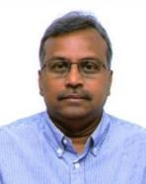
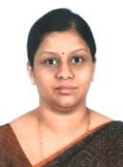

QUALIFIED MANAGEMENT WITH DEEP UNDERSTANDING OF APPAREL SECTOR
Mr P. Sundararajan
Chairman and Managing Director
`
Ms S. Latha
Executive Director
Founder director of SPAL with 28 years of experience in the textile and apparel industry
Mr S. Chenduran
Director
Founder director of SPAL with 35 years of experience in the textile and apparel industry
Bachelor of Science from the Bangalore University
Six years of experience in the textile and apparel industry
MS in Business and Management from the University of Strathclyde
Ms S . Shantha, Joint Managing Director
B.Tech (Textiles) graduate and MBA from PSG Institute of Management.
Immense knowledge in marketing and textiles makes her contribution valuable to achieve the visions of the Company
Ms P.V. Jeeva, Chief Executive Officer
34 years of experience in the textile and apparel industry
Handles garments division and has been associated with SPAL since July, 1986
Diploma in textile processing from GRG Polytechnic College, Coimbatore
Mr V. Balaji, Chief Finance Officer
20 years of experience in the field of finance and accounts
Associated with SPAL since May 2012
Qualified Chartered Accountant
Helped in managing banking relationships to aid the growth of the Company

Slide 17
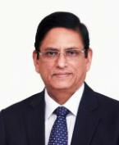

BOARD OF DIRECTORS – WIDE SPECTRUM OF EXPERIENCE
Mr A.S. Anandkumar
Independent Director
Mrs H .Lakshmi Priya
Independent Director
47 years of experience in banking
20+ years of experience in corporate advisory, contract documentation, private equity & venture capital
Masters of Science from the University of Madras
BA, LLB (Hons) from National las School of India University, Bangalore in 1996 and is a member of the Bar council of Maharashtra and Goa since 1999
Mr C. R. Rajagopal
Independent Director
Mr V. Sakthivel
Independent Director
44 years of experience in the fields of commerce and accountancy
Core areas of expertise - finance, private equity, mergers, acquisitions and reorganisations
Chartered Accountant having 35+ years of experience
Qualified Chartered Accountant and Certified I.S. Auditor

Slide 18
SHAREHOLDING STRUCTURE
SHAREHOLDING PATTERN – 2nd September 2022
KEY INSITUTIONAL SHAREHOLDERS – 2nd September 2022
DSP Mutual Fund | 8.40%
ICICI Prudential Mutual Fund | 3.75%
UTI Mutual Fund | 3.33%
Franklin India Smaller Companies Fund | 0.49%
Quant Mutual Fund – Quant Tax Plan | 0.45%
KEY HNI SHAREHOLDERS – 2nd September 2022
Ashish Kacholia | 0.77%
Kesavapillai Annamalai | 0.77%
V Senthil | 0.67%
Sushmita Ashish Kacholia | 0.38%
Dolly Khanna | 0.36%
Source: BSE

Slide 19
Thank You

